Slide 1


Nova Mart – Promotional Campaign Analysis
Somesh Joshi | Data Science Intern
Data Science | AtliQ Technologies Pvt. Ltd.
Notes:
Good morning, and thank you for joining this session. In this presentation, I’ll be sharing our analysis of Nova Mart’s Sankranti 2024 promotional campaign, focusing on how promotions influenced sales and revenue performance

Slide 2
Nova Mart
Objectives
🏬 Store Distribution
📦 Pre-Promotion Demand
🛒 Category Sales (Sankranti)
📈 ISU% by City
💲 Price–Sales Relationship
🎁 Promo Effectiveness in Hyderabad
💹 Bengaluru Revenue Impact
AtliQ
Notes:
Our analysis addresses seven key business questions: store distribution across cities, category sales contributions, the relationship between price and sales, pre-promotion demand patterns, ISU% by city, promotion effectiveness in Hyderabad, and revenue performance in Bengaluru.

Slide 3
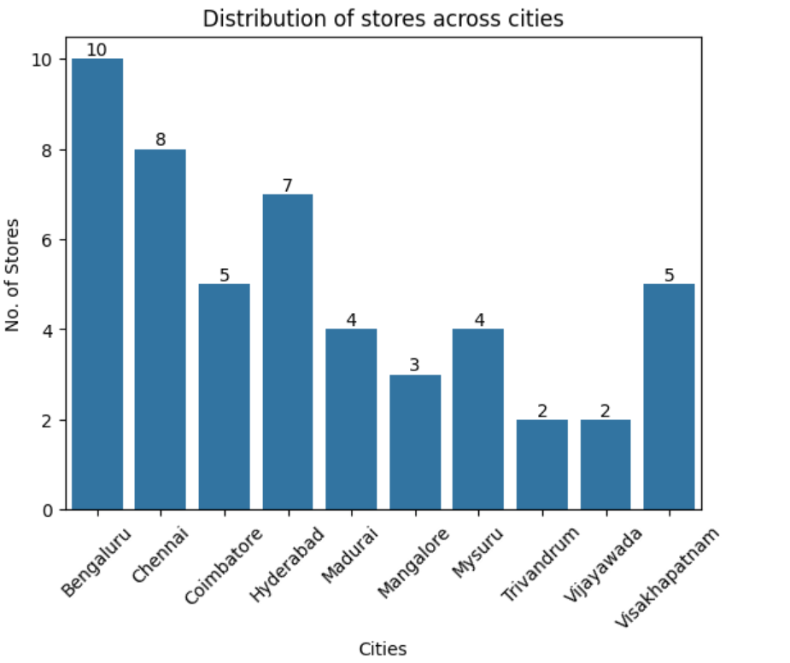
Nova Mart
Store Distribution
Key Insights
Metros dominate: Bengaluru (10), Chennai (8), Hyderabad (7).
Mid-tier: Coimbatore & Visakhapatnam (5 each).
Smaller markets: Madurai (4), Mysuru (4), Mangalore (3).
Minimal presence: Trivandrum & Vijayawada (2 each).
Overall: Strong metro focus, limited tier-2 expansion.
AtliQ
Notes:
Bengaluru has the largest store presence with ten outlets, followed by Chennai with eight and Hyderabad with seven. Mid-tier cities like Coimbatore and Visakhapatnam have five stores each, while smaller markets such as Madurai, Mysuru, and Mangalore have fewer. Trivandrum and Vijayawada have only two stores each, showing limited presence.

Slide 4
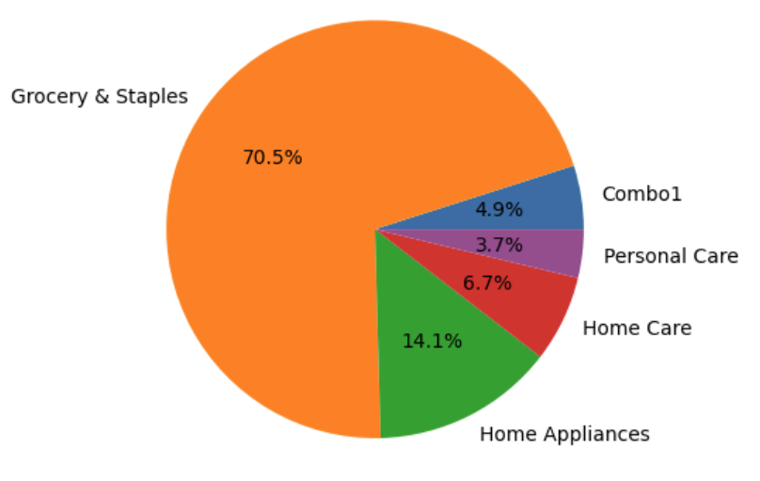
Nova Mart
Sales Contribution by Product Category – Sankranti
Key Insights
Grocery & Staples lead (70.5%) – core driver of Sankranti sales.
Home Appliances (14.1%) – secondary contributor.
Home Care (6.7%) & Personal Care (3.7%) – smaller but notable shares.
Combo Offers (4.9%) – effective in boosting additional sales.
Sales mix shows essentials dominate over discretionary categories.
AtliQ
Notes:
"During Sankranti 2024, Grocery and Staples dominated sales, contributing over seventy percent of the total. Home Appliances contributed about fourteen percent, while Home Care, Personal Care, and Combo offers accounted for smaller shares."

Slide 5
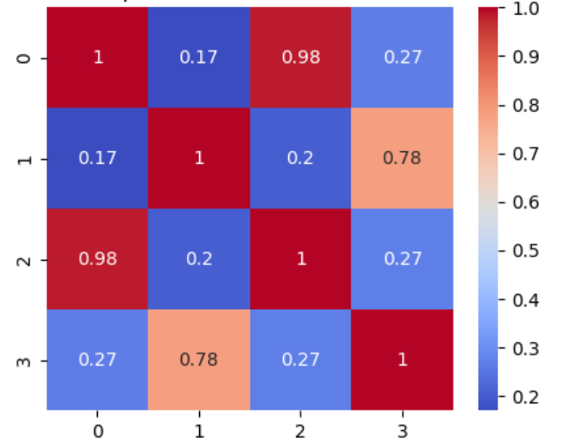
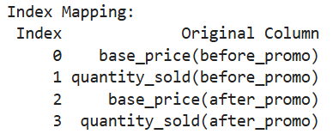
Nova Mart
Price vs Sales Quantities
Key Insights
Weak positive correlation (0.27).
Slight sales increase with higher prices.
Price not a strong sales driver post-promo.
Other factors (promotions, offers) influence more.
AtliQ
Notes:
The correlation between base price after promotion and sales quantity was weakly positive, at zero point two seven. This means price alone was not a strong driver of sales, with promotions and other factors playing a more significant role.

Slide 6
Nova Mart
Pre-Promotion Demand by Category
Key Insights
Grocery & Staples: Strong baseline demand (centered 250–400). Promotions may add incremental gains.
Home Care: Lower baseline demand (20–60). Promotions can drive high volume uplift.
Personal Care: Moderate steady demand (30–70). Promotions useful for shifting demand upward.
Home Appliances: Wide spread, variable demand. Promotions should focus on high-value items.
Combo1 (Bundles): Bimodal demand (low 80–150, high 300–400). Promotions must be bundle-specific.
Recommended Promotions
Grocery & Staples → 25%–33% OFF (small discounts boost loyalty).
Home Care → BOGOF / 50% OFF (push low baseline demand).
Combo1 Bundles → BOGOF for small buyers, deeper % OFF for bulk buyers.
Home Appliances → Cashback / selective 50% OFF (focus on slow movers).
Personal Care → 25%–33% OFF or Cashback (balance price-sensitive & premium items).
AtliQ

Slide 7
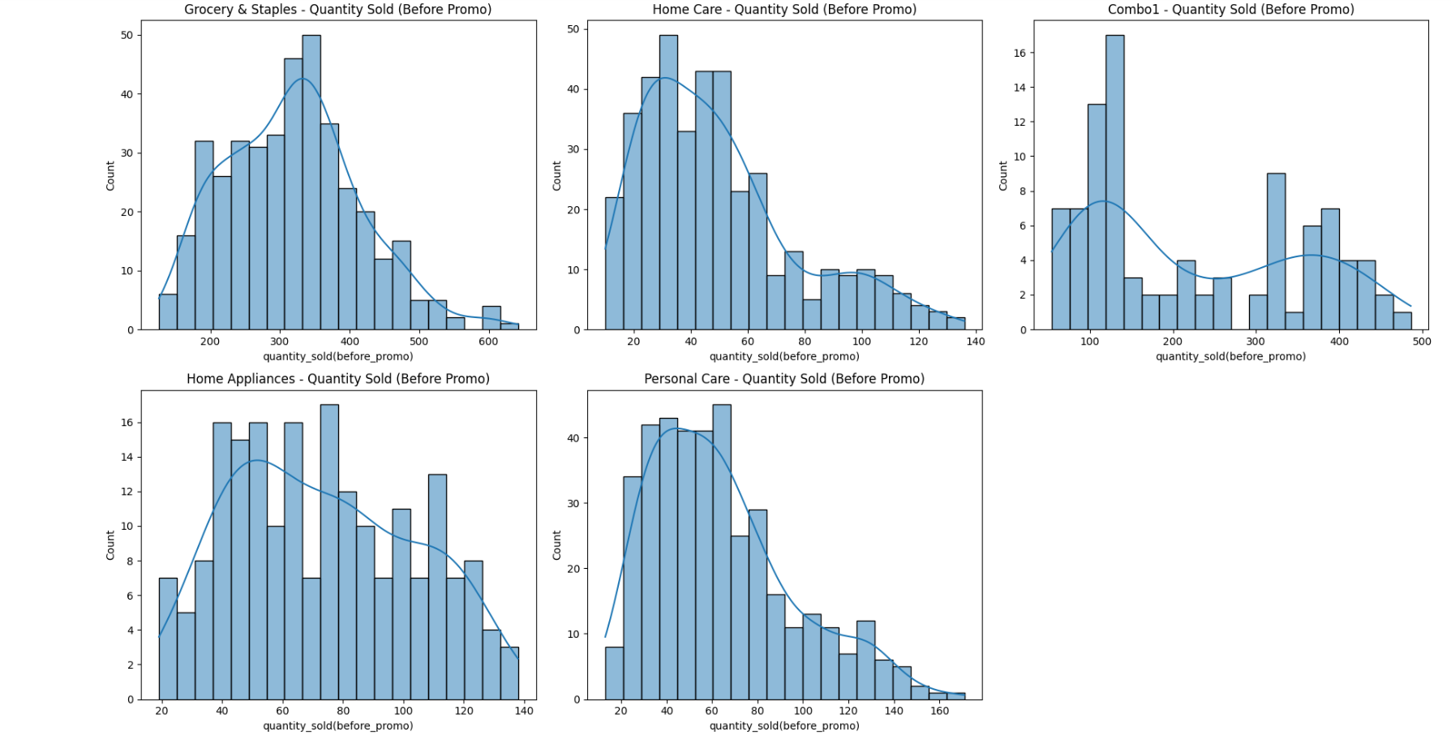

Slide 8
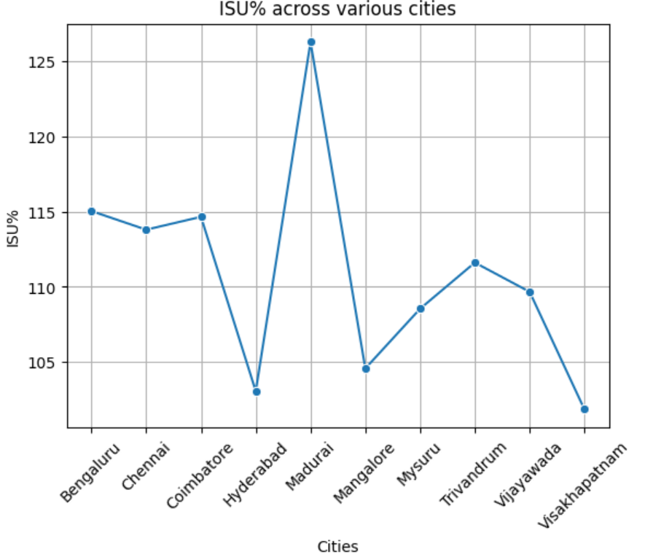
Nova Mart
Incremental Sold Units % (ISU%) by City
Key Insights
Madurai (~127%) → highest uplift, very responsive to promotions.
Visakhapatnam (~102%) → smallest uplift, limited promo impact.
Metro cities (Bengaluru, Chennai, Hyderabad) → moderate uplift (~110–115%), stable baseline demand.
Trend: Tier-2/3 cities are more promotion-sensitive than metros.
AtliQ
Notes:
Madurai recorded the highest sales uplift at around one hundred and twenty-seven percent, while Visakhapatnam showed the lowest at about one hundred and two percent. Metro cities like Bengaluru, Chennai, and Hyderabad recorded moderate uplifts between one hundred and ten and one hundred and fifteen percent.

Slide 9
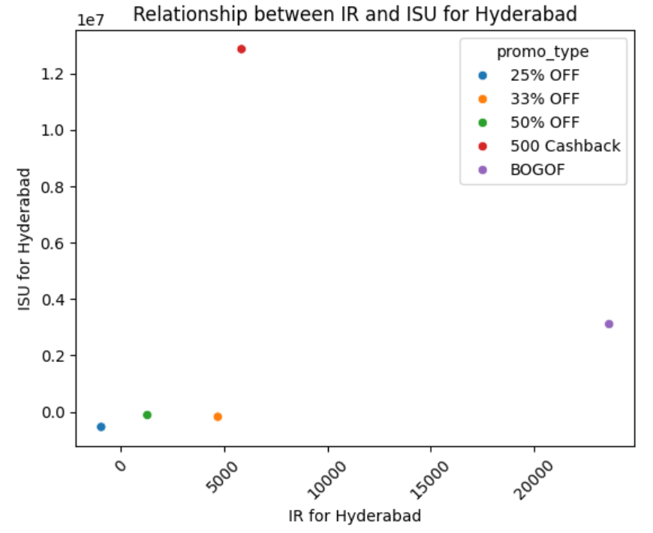
Nova Mart
Promotion Effectiveness (Hyderabad)
Key Insights
Cashback → highest ISU% (sales volume uplift).
BOGOF → highest IR% (revenue growth).
25% OFF → weakest performer (drop in both ISU% & IR%).
Insight: Cashback boosts volumes, while BOGOF maximizes revenue; flat % discounts risk underperformance.
AtliQ
Notes:
"In Hyderabad, Cashback delivered the highest increase in sales volume, while Buy One Get One Free generated the largest revenue uplift. Percentage discounts, however, had limited impact."

Slide 10
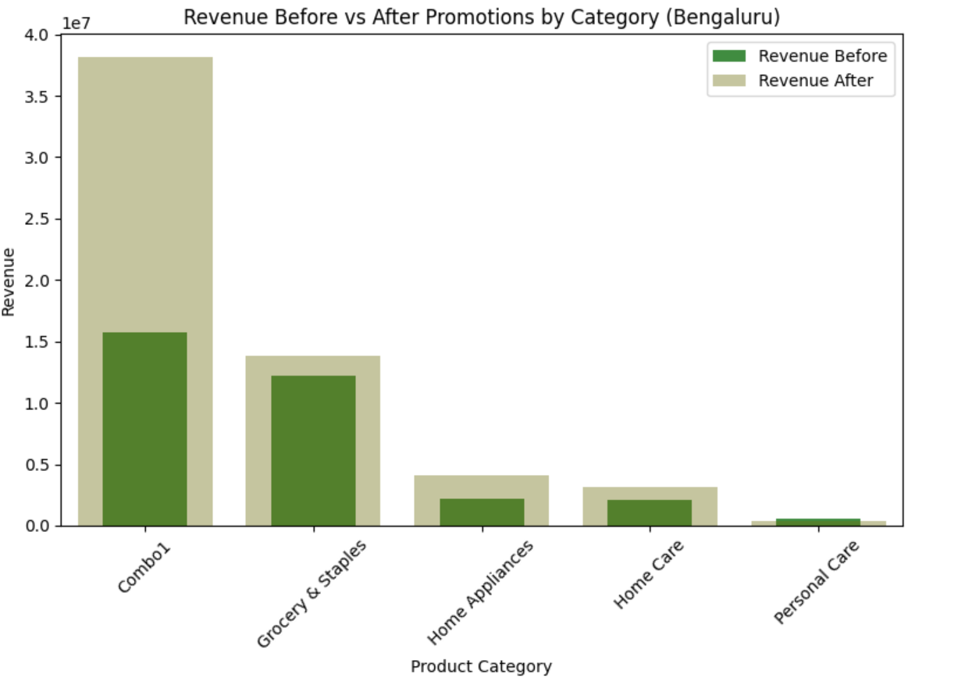
Nova Mart
Revenue Impact in Bengaluru
Key Insights
Combo1 drove the largest revenue uplift — biggest winner of promotions in Bengaluru.
Grocery & Staples showed steady growth, strengthening its dominant position.
Home Appliances nearly doubled revenue, showing strong responsiveness to promotions.
Home Care improved moderately, while Personal Care showed minimal impact.
AtliQ
Notes:
For maximizing revenue growth → Focus on bundling strategies (Combo1).
For steady demand maintenance → Continue light promotions in Grocery & Staples.
For durable goods (Home Appliances) → Use cashback/EMI offers instead of deep discounts.
For Home Care & Personal Care → Rely on brand-building and targeted marketing beyond promotions.

Slide 11
Nova Mart
Thankyou
AtliQ
Notes:
To conclude, the Sankranti campaign was most effective in driving sales of essentials and in tier-two cities like Madurai. Cashback and BOGOF proved to be the most impactful promotion types, while flat percentage discounts were less effective. Overall, promotions significantly boosted revenue, particularly in Bengaluru.

